Slide 1
Window-based Stream Data Analytics with SPARK and Kafka
2. Spark Setup

Slide 2
Learning Outlines
Apache Spark Installation Requirements
Apache Spark
Installing Apache Spark
Initializing Apache Spark
Databricks

Slide 3
Learning Outlines
Apache Spark Installation Requirements
Apache Spark
Installing Apache Spark
Initializing Apache Spark
Databricks

Slide 4
OS INFO
Linux is well supported by almost all big data frameworks.
Mac (Unix-like) should work for most frameworks.
Windows is not well supported and may need more effort to make it work.
We do not recommend you to use Windows in this course. It is not fully compatible and hard to debug!

Slide 5
Verifying Java Installation
Before installing Spark, the system must have installed Java.
Following command will verify the Java version:
$java -version
If it is already installed on the system, the output should be as follows:
java version "1.8.0_144"
Java(TM) SE Runtime Environment (build 1.8.0_144-b01)
Java HotSpot(TM) 64-Bit Server VM (build 25.144-b01, mixed mode)
If Java is not installed on system, install it before proceeding to the next steps.

Slide 6
Verifying Scala Installation
Before installing Spark, the system must have installed Scala to start Spark.
Following command will verify the Scala version:
$scala -version
If it is already installed on the system, the output should be as follows:
Scala code runner version 2.11.6 — Copyright 2002-2013, LAMP/EPFL
If Scala is not on the system, then download it and set its path before proceeding to the next steps.

Slide 7
Learning Outlines
Apache Spark Installation Requirements
Apache Spark
Installing Apache Spark
Initializing Apache Spark
Databricks

Slide 8
Download and Install Apache Spark
http://spark.apache.org/downloads.html
Unzip it and extract it to a directory by following command:
$ tar xvf spark-2.2.0-bin-hadoop2.7.tgz
Rename the spark directory:
﻿$ mv spark-2.2.0-bin-hadoop2.7/ spark/

Slide 9
Setup Spark
Enter following command in terminal:
vim ~/.profile
Add path to environment variables by adding the following command in your ~/.profile
export SPARK_HOME=/home/usr/Documents/apps/spark
export PYTHONPATH=$SPARK_HOME/python/:$PYTHONPATH
export PYTHONPATH=$SPARK_HOME/python/lib/py4j-0.8.2.1-src.zip:$PYTHONPATH
﻿export PATH=$PATH:/home/usr/Documents/spark/bin
Save it by press <ESC> and enter :wq, then press <Enter>
Run following command
source ~/.profile

Slide 10
Verifying the Spark Installation
In a Terminal, write the following commands:
To start spark session for python language:
./bin/pyspark
./bin/pyspark --master local[2]
To start spark session for scala language:
./bin/spark-shell
./bin/spark-shell --master local[2]
‘—master’ option specifies the master URL for a distributed cluster, or local to run locally with one thread, or local[N] to run locally with N threads

Slide 11
Learning Outlines
Apache Spark Installation Requirements
Apache Spark
Installing Apache Spark
Initializing Apache Spark
Databricks

Slide 12
Run Example
Spark comes with several sample programs.
Scala, Java, Python and R examples are in the examples/src/main directory.
Open a terminal, use the following command for Java or Scala:
./bin/run-example <class> [params]
For example:
./bin/spark-submit examples/src/main/python/pi.py 10

Slide 13
Initializing Spark
Python:
from pyspark import SparkConf, SparkContext conf = SparkConf().setMaster("local").setAppName("My App") sc = SparkContext(conf = conf)
Scala:
import org.apache.spark.SparkConf
import org.apache.spark.SparkContext
import org.apache.spark.SparkContext._
val conf = new SparkConf().setMaster("local").setAppName("My App").set("spark.driver.allowMultipleContexts", "true")
val sc = new SparkContext(conf)
val input = sc.textFile("/input/text.txt")
val count = input.flatMap (line ⇒ line.split (" ")).map (word ⇒ (word, 1)).reduceByKey (_ + _)
count.collect()

Slide 14
Initializing Spark (Cont’d)
Java:
import org.apache.spark.SparkConf; import org.apache.spark.api.java.JavaSparkContext; SparkConf conf = new SparkConf().setMaster("local").setAppName("My App"); JavaSparkContext sc = new JavaSparkContext(conf);
A cluster URL, namely ‘local’ in these examples, which tells Spark how to connect to a cluster.
local is a special value that runs Spark on one thread on the local machine, without connecting to a cluster.
An application name, namely ‘My App’ in these examples. This will identify your application on the cluster manager’s UI if you connect to a cluster.

Slide 15
Learning Outlines
Apache Spark Installation Requirements
Apache Spark
Installing Apache Spark
Initializing Apache Spark
Databricks

Slide 16
Alternative: Databricks
You can use Apache Spark on Databricks cloud instead of standalone version on your machine
Databricks is
a managed platform for running Apache Spark
a point and click platform for those that prefer a user interface like data scientists or data analysts
Databricks provides ‘Community Edition’ platform for students and educational institutions for free of cost:
https://databricks.com/try-databricks
https://databricks.com/spark/getting-started-with-apache-spark

Slide 17
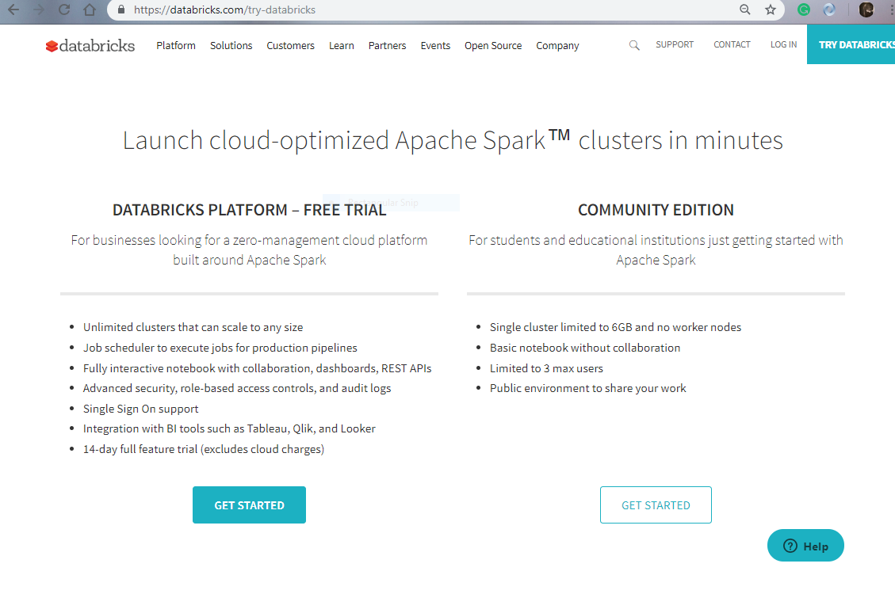
Databricks

Slide 18
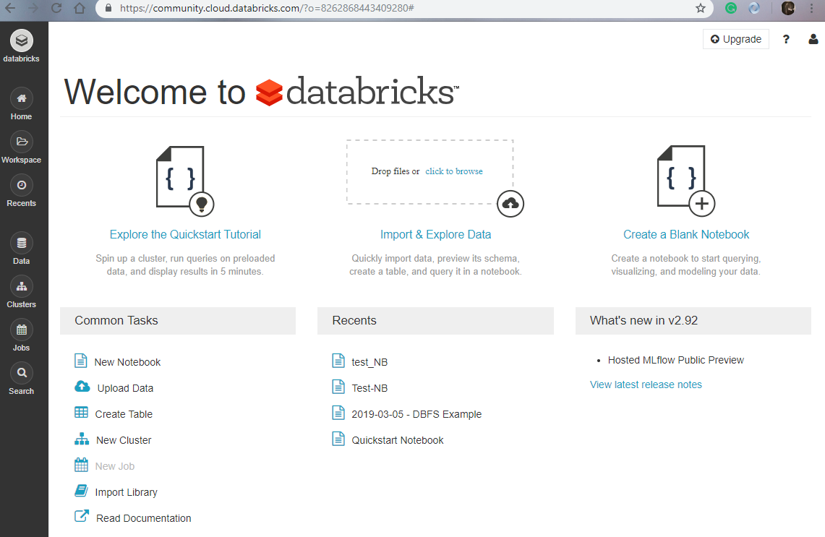

Slide 19
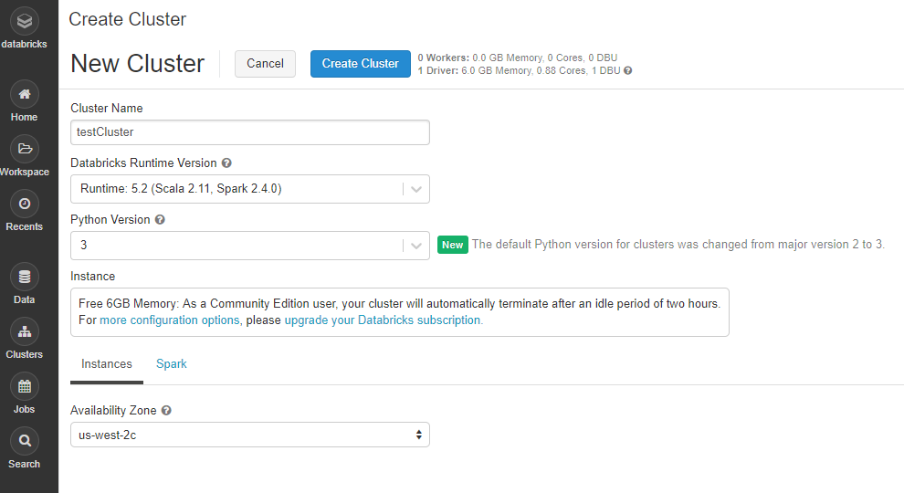
Creating a cluster

Slide 20
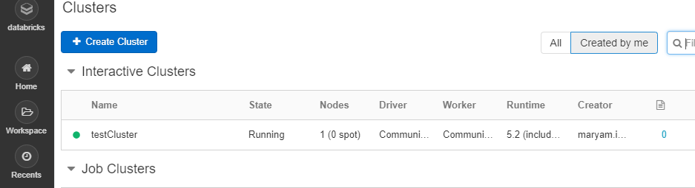

Slide 21
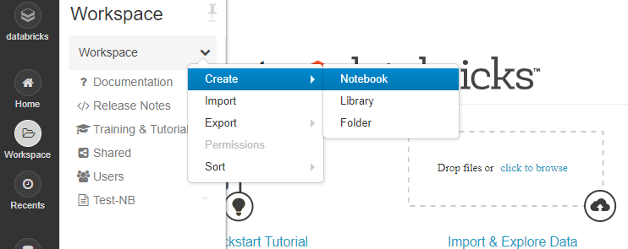
Adding a Notebook to the Cluster

Slide 22
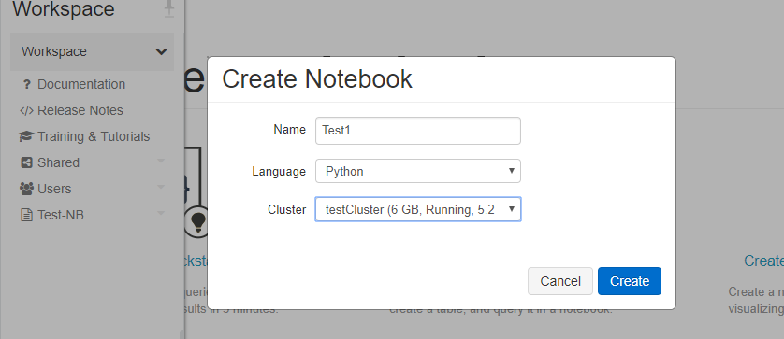

Slide 23
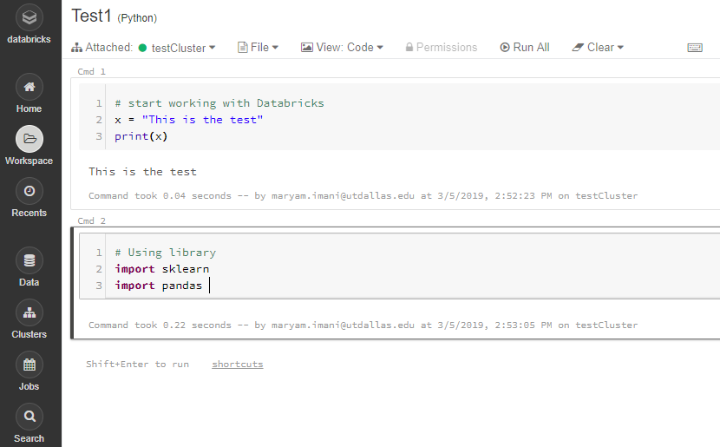

Slide 24
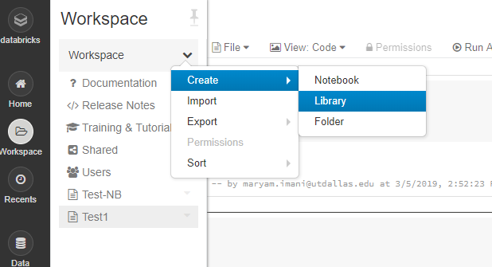
Adding libraries

Slide 25
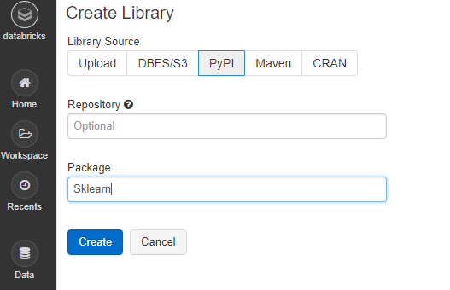
Adding libraries

Slide 26
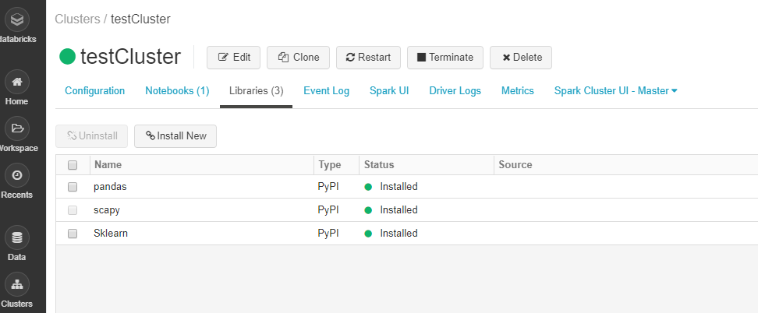
Installed libraries on the cluster

Slide 27
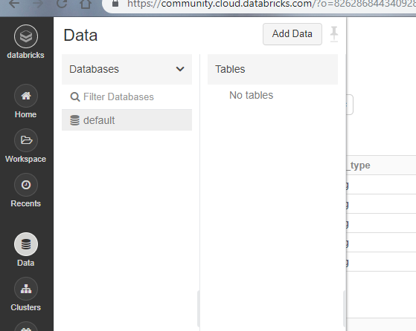
Adding Data

Slide 28
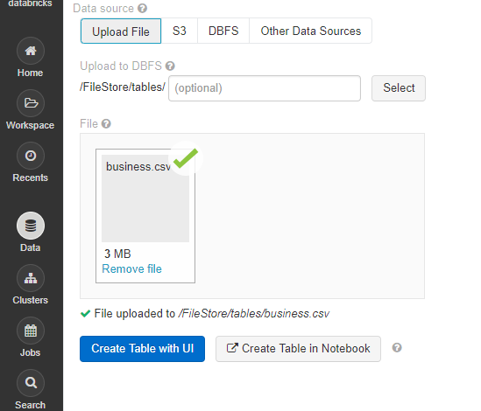

Slide 29
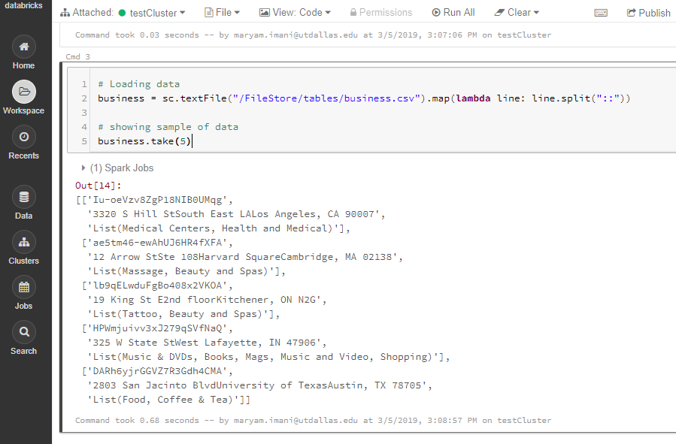

Slide 30
Next Lesson
We will also give some example in pyspark about how to extract features from documents:
Tokenizer
Stop word removal
n-gram
TF-IDF
word2vec
We will also give some example in pyspark about how to classify documents with extracted features:
Decision Tree
Naive Bayes
SVM

